Slide 1
Using Flashback Database in a Data Guard Configuration

Slide 2
Objectives
After completing this lesson, you should be able to:
  Explain the advantages of using Flashback Database in a Data Guard configuration
  Configure Flashback Database
Notes:
Oracle Database 11g: Data Guard Administration 10 - <number>

Slide 3
Using Flashback Database in a
Data Guard Configuration
  Flashback Database provides the following in a Data Guard configuration:
    An alternative to restoring and recovering the primary database
    A way to reinstate the primary database that was disabled as part of a failover to a physical standby database operation
    An alternative to delaying the application of redo to protect against user errors or logical corruptions
  Flashback Database must be configured to use the following features in a Data Guard configuration:
    Fast-start failover
    Snapshot standby
  Flashback Database is recommended when using the broker because the broker automatically enables real-time apply.
Notes:
Oracle Database 11g: Data Guard Administration 10 - <number>
Using Flashback Database in a Data Guard Configuration
Flashback Database provides the following advantages in a Data Guard configuration:
Provides an alternative to delaying the application of redo to protect against user errors or logical corruptions. By using Flashback Database in this context, standby databases are more closely synchronized with the primary database, thereby reducing failover and switchover times.
Eliminates the need to completely re-create the original primary database after a failover. The failed primary database can be flashed back to a point in time before the failover and converted to be a standby database for the new primary database.
Flashback Database is required in a Data Guard configuration for the following features:
Fast-start failover: You must enable Flashback Database and set up a flash recovery area on the primary database and the target standby database before enabling fast-start failover. (See the lesson entitled “Enabling Fast-Start Failover” for additional information.)
Snapshot standby: To convert a physical standby database to a snapshot standby database, you must enable Flashback Database. (See the lesson titled “Creating and Managing a Snapshot Standby Database” for additional information.)
Because the broker automatically enables real-time apply, the use of Flashback Database is recommended when you use the broker to manage your configuration.

Slide 4




Overview of Flashback Database
The Flashback Database operation:
  Works like a “rewind” button for the database
  Can be used when users make logical data corruptions
Errors are generated.
The database is corrupted.
"Press the rewind button"
(FLASHBACK DATABASE).
The database is "rewound."
Notes:
Oracle Database 11g: Data Guard Administration 10 - <number>
Overview of Flashback Database
With Flashback Database, you can quickly bring your database to an earlier point in time by undoing all changes that took place since that time. This operation is fast because you do not need to restore backups. You can use this feature to undo changes that resulted in logical data corruptions.
When you use Flashback Database, Oracle Database uses past block images to back out changes to the database. During normal database operation, Oracle Database occasionally logs these block images in flashback logs, which are written sequentially and are not archived. Oracle Database automatically creates, deletes, and resizes flashback logs in the flash recovery area. You need to be aware of flashback logs only for monitoring performance and deciding how much disk space to allocate to the flash recovery area for flashback logs.
The time it takes to rewind a database with Flashback Database is proportional to how far back in time you need to go and the amount of database activity after the target time. The time it would take to restore and recover the whole database could be much longer. The before images in the flashback logs are used only to restore the database to a point in the past, and forward recovery is used to bring the database to a consistent state at some time in the past. Oracle Database returns data files to the previous point in time—but not auxiliary files such as initialization parameter files.
Flashback Database can also be used to complement Data Guard and Recovery Advisor and to synchronize clone databases.

Slide 5


Configuring Flashback Database
1. Configure the flash recovery area.
2. Set the retention
target.
3. Enable Flashback Database.
SQL> SHUTDOWN IMMEDIATE;
SQL> STARTUP MOUNT;
SQL> ALTER SYSTEM SET
2 DB_FLASHBACK_RETENTION_TARGET=2880 SCOPE=BOTH;
SQL> ALTER DATABASE FLASHBACK ON;
SQL> ALTER DATABASE OPEN;
Notes:
Configuring Flashback Database
1. Configure the flash recovery area.
2. Set the retention target with the DB_FLASHBACK_RETENTION_TARGET initialization parameter.
You can specify an upper limit, in minutes, on how far back you want to be able to flash back the database. The example uses 2,880 minutes, which is equivalent to two days. This parameter is only a target and does not provide any guarantee. Your flashback time interval depends on how much flashback data was kept in the flash recovery area.
3. Enable Flashback Database with the following command:
ALTER DATABASE FLASHBACK ON;
Before you can issue the command to enable Flashback Database, the database must be configured for archiving and started in MOUNT EXCLUSIVE mode.
Determine whether Flashback Database is enabled with the following query:
SELECT flashback_on FROM v$database;
Disable Flashback Database with the ALTER DATABASE FLASHBACK OFF command. As a result, all existing Flashback Database logs are deleted automatically.
Note: Enable Flashback Database only when the database is mounted in exclusive mode rather than open.

Slide 6
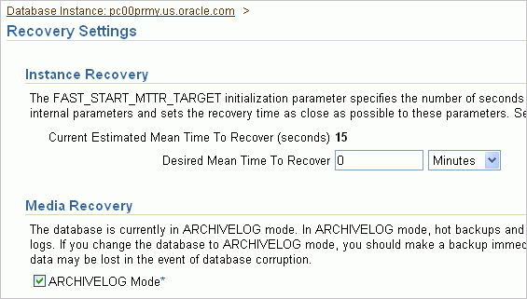
Configuring Flashback Database by Using Enterprise Manager
Verify that the database is in ARCHIVELOG mode:
Notes:
Configuring Flashback Database by Using Enterprise Manager
1. On the Availability page, select Recovery Settings in the Backup/Recovery region.
2. Ensure that your database is in ARCHIVELOG mode. If not, select ARCHIVELOG Mode.

Slide 7
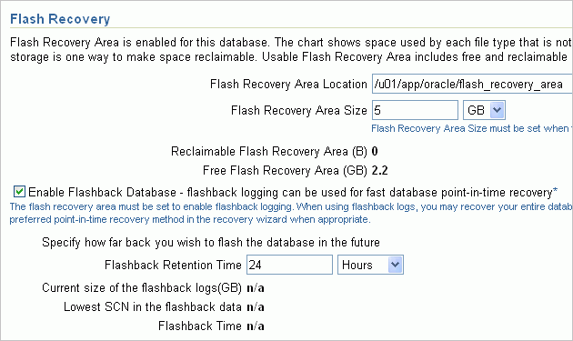
Configuring Flashback Database by Using Enterprise Manager
Set the flash recovery area and enable Flashback Database:
Notes:
Configuring Flashback Database by Using Enterprise Manager (continued)
3. Review the flash recovery area location.
The flash recovery area is a unified storage location for all recovery-related files and activities in an Oracle database. All files that are needed to completely recover a database from a media failure are part of the flash recovery area. The recovery-related files that can be created in the flash recovery area include archived redo log files, control files, backups created by Recovery Manager (RMAN), flashback logs, and the change tracking file. By allocating a storage location and unifying recovery-related files in a specific area, the Oracle database server relieves the database administrator from having to manage the disk files created by these components. The default location for the flash recovery area is $ORACLE_BASE/flash_recovery_area. If you want it in a different location, specify the location in the Flash Recovery Area Location field. When the flash recovery area and archiving are configured, USE_DB_RECOVERY_FILE_DEST is configured for archive log destination 10.
4. Set the flash recovery size in the Flash Recovery Area Size field.
5. Select Enable Flashback Database. You can also set the flashback retention time, and you can view important information regarding your flashback database window.
6. Scroll down to the bottom of the Recovery Settings page, and click Apply to restart the database instance to implement your changes.

Slide 8



Using Flashback Database
Instead of Apply Delay
Standby1
No delay
Primary database
Standby2
4-hour delay
Standby3
8-hour delay
Primary database
Standby
Notes:
Oracle Database 11g: Data Guard Administration 10 - <number>
Using Flashback Database Instead of Apply Delay
As an alternative to the Apply Delay configuration option, you can use Flashback Database to protect against the application of corrupted or erroneous data to the standby database. Flashback Database can quickly and easily flash back a standby database to an arbitrary time in the past. You can configure one standby database with Flashback Database to achieve the same benefit as multiple standby databases with different delays.

Slide 9

Using Flashback Database and
Real-Time Apply
RFS
Primary database
MRP
Standby
redo log
ARC0
Archived
redo logs
Standby database
Notes:
Oracle Database 11g: Data Guard Administration 10 - <number>
Using Flashback Database and Real-Time Apply
The Oracle Data Guard real-time apply feature reduces failover time. Flashback Database protects a physical standby database from logical data corruption and user error.
The Data Guard broker automatically enables real-time apply.

Slide 10
Using Flashback Database After RESETLOGS
Primary database
Standby database
Redo
RESETLOGS
after
point-in-time
recovery
Flashback
Redo
Primary database
Standby database
Notes:
Oracle Database 11g: Data Guard Administration 10 - <number>
Using Flashback Database After RESETLOGS
Physical Standby Configuration
For a physical standby database, it is possible that the Redo Apply service might not halt when it encounters the OPEN RESETLOGS command in the redo information. If the physical standby database’s SCN (system change number) is far enough behind the primary database’s SCN, then the Redo Apply service can interpret the OPEN RESETLOGS command without stopping.
Note: Recall that the “recovery through RESETLOGS” feature was implemented in Oracle Database 10g.
Use the following procedure to avoid re-creating a standby database after you issue an OPEN RESETLOGS command on the primary database and the managed recovery process is halted on the physical standby database:
1. On the primary database, determine an SCN that is at least two SCNs prior to the SCN when the OPEN RESETLOGS command was issued. This is necessary to enable the standby to recover properly through OPEN RESETLOGS. Use the following query to find the “before RESETLOGS” SCN:
SELECT TO_CHAR(resetlogs_change# - 2) FROM v$database;
2. On the standby database, obtain the current SCN by using the following query:
SELECT TO_CHAR(current_scn) FROM v$database;

Slide 11
Notes:
Oracle Database 11g: Data Guard Administration 10 - <number>
Using Flashback Database After RESETLOGS (continued)
3. Flash back the standby database to the “before RESETLOGS” SCN that you queried in
step 1:
FLASHBACK STANDBY DATABASE TO SCN <before RESETLOGS SCN>;
4. Restart managed recovery on the standby database. The standby database will be ready to receive and apply logs from the primary database.
ALTER DATABASE RECOVER MANAGED STANDBY DATABASE DISCONNECT;
Logical Standby Configuration
For a logical standby database, it is possible that the SQL Apply service might not halt when it encounters the OPEN RESETLOGS command in the redo information. If the logical standby database’s SCN is far enough behind the primary database’s SCN, the SQL Apply service will be able to interpret the OPEN RESETLOGS command without stopping.
Use the following procedure to avoid re-creating a standby database after you perform an OPEN RESETLOGS on the primary database and the SQL Apply process has halted on the logical standby database:
1. On the primary database, determine an SCN that is at least two SCNs prior to the SCN when the OPEN RESETLOGS command was issued. This is necessary to enable the standby to recover properly through OPEN RESETLOGS. Use the following query to find the “before RESETLOGS” SCN:
SELECT TO_CHAR(resetlogs_change# - 2) FROM v$database;
2. On the standby database, obtain the current SCN by using the following query:
SELECT TO_CHAR(current_scn) FROM v$database;
3. Flash back the standby database to the “before RESETLOGS” SCN that you queried in
step 1:
FLASHBACK STANDBY DATABASE TO SCN <before RESETLOGS SCN>;
4. Restart SQL Apply on the standby database. The standby database will be ready to receive and apply logs from the primary database.
ALTER DATABASE START LOGICAL STANDBY APPLY IMMEDIATE;

Slide 12
Flashback Through Standby Database
Role Transitions
  Use Flashback Database to flash back a database to a point in time before a switchover or failover.
  Primary and standby databases retain their current roles when you flash back through physical standby switchovers or failovers.
  Database roles are flashed back when you flash back through logical standby switchovers or failovers.
  Flashback Database can be used to undo a physical database activation.
Notes:
Flashback Through Standby Database Role Transitions
Use Flashback Database to revert a database to a point in time before a physical standby database switchover or failover. The database role does not change when flashing back through a physical standby switchover, failover, or activation.
In a logical standby database, the FLASHBACK DATABASE command reverts the database to a system change number (SCN) or time stamp before a switchover or failover. For a logical standby database, the database reverts to its original role at the time of the flashback SCN or flashback time.
You can also use Flashback Database to undo a physical standby activation.
Note: For detailed information about switchover and failover, see the lesson titled “Performing Role Transitions.”

Slide 13
Using Flashback Database After Failover
Primary database
Standby database
Redo
Flashback
Failover
Redo
New standby database
New primary database
Notes:
Using Flashback Database After Failover
You invoke a failover operation when a catastrophic failure occurs on the primary database and there is no possibility of recovering the primary database in a timely manner. After a failover operation, the old standby database becomes the new primary database, and the old primary database is placed in the “needs reinstatement” state.
Note: Detail on reinstating the database is provided in the lesson titled “Performing Role Transitions.”
Use the Flashback Database feature to convert the old primary database into a new standby database without re-creating the database. You can flash back the old primary database so that it contains only those changes that are already applied to the old standby database. This enables you to convert the old primary database into a new standby database without restoring the old primary database.
Note: You must enable the Flashback Database feature on the old primary database.

Slide 14
Summary
In this lesson, you should have learned how to:
  Enable Flashback Database
  Use Flashback Database effectively in a Data Guard configuration
Notes:
Oracle Database 11g: Data Guard Administration 10 - <number>

Slide 15
Practice 10: Overview
This practice covers enabling Flashback Database:
  On the primary database
  On the standby database
Notes:
Oracle Database 11g: Data Guard Administration 10 - <number>

Slide 16
Notes:
Oracle Database 11g: Data Guard Administration 10 - <number>

